Slide 1

Realtime Estate Analysis
Tanmay Vinod Itkelwar
txi220001
BUAN 6340.001
Programming for Data Science

Slide 2
Introduction
Goal:
To automate the price prediction of real estate across USA
Reference:
Website link https://www.bunsly.com/demo/homeharvest
Git repo: https://github.com/Bunsly/HomeHarvest
Python library: homeharvest

Slide 3
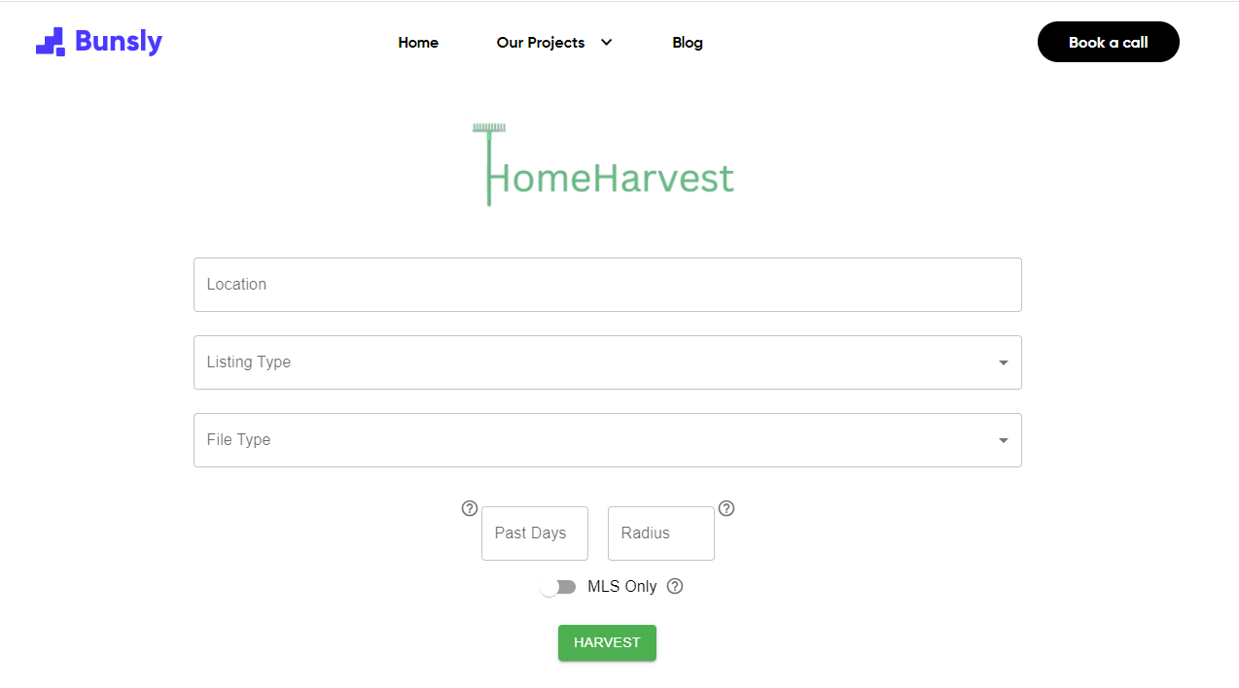
Getting Data
Parameters needed:
Radius
Time
Location
Listing Type

Slide 4
Variable Selection
Dependent Variable : List_price
Independent Variable
Style
Beds
Half_baths
Sqft
Year_built
Nearby_schools
Parking_garage
Days_on_mls
Lot_sqft
Price_per_sqft
Stories
Hoa_fee

Slide 5
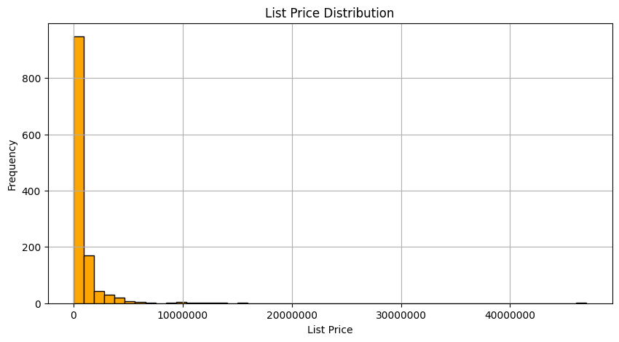
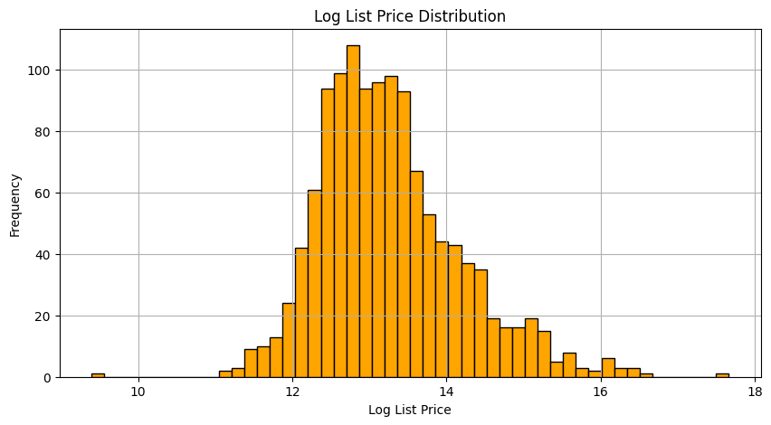
Data cleaning

Slide 6
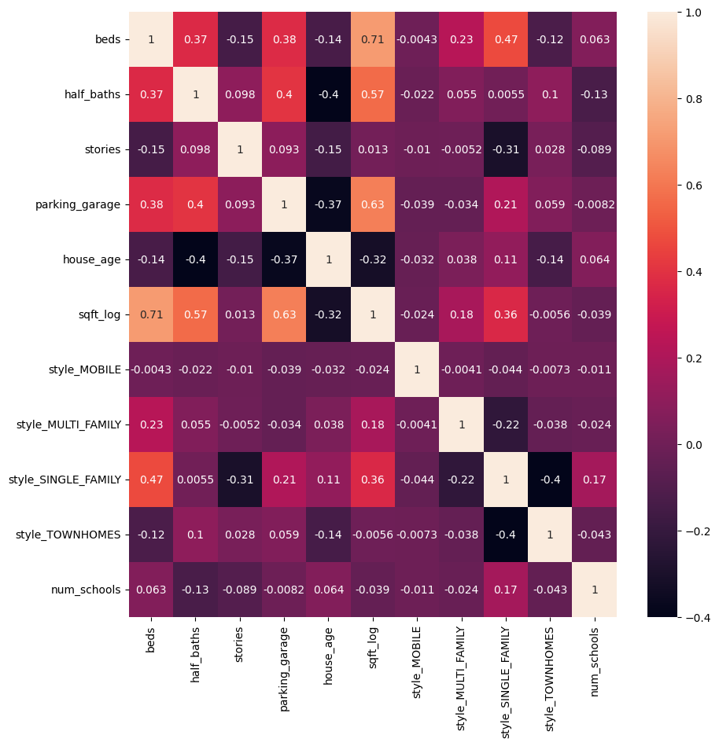
Correlation Analysis
SR. no | Feature | VIF
0 | beds_2 | 2.665144
1 | beds_3 | 4.595639
2 | beds_above | 5.605618
3 | half_baths | 2.558123
4 | stories | 1.460446
5 | parking_garage | 4.495801
6 | house_age | 3.17623
7 | sqft | 4.091195
8 | num_schools | 6.453327

Slide 7
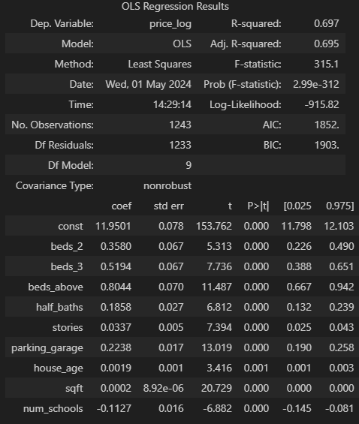
Regression Output
If the house has 2 Bedrooms, the price Increases by 35%.
If the house has 3 Bedrooms, the price Increases by 51%.
An additional increase of 100 square feet increases the house price by 2%

Slide 8
Interpretation
For my House
beds = 3
half_baths = 3
stories = 2
parking_garage = 2
house_age = 5
sqft = 1900
num_schools = 4
Log Price: 13.4806
Price: $ 715,402.0

Slide 9
Texas Market

Slide 10
Future work
USA level analysis
Time series model
Predicting high values assets
Prediction of good properties to invest

Slide 11

Thankyou

